Slide 1



Understanding Instabilities in a 4-Node Star Electrical Grid
BIT 5534 Spring 2022
Group 9
Debbie Thomas, Matias ruiz ranz, khatera ibrahimi

Slide 2







Outline
  Business problem
  Solution
  Understanding the Data
  Models Overview
    Models Created
    Models Selection
  Conclusions and Recommendations

Slide 3








Business Problem
Stability
New energy sources have made maintaining the stability of power grids complex
Efficiency
The system’s response to demand fluctuation is key to the efficiency of the system
Supply & Demand
Demand changes over the course of the day. Suppliers have to control undersupply and oversupply

Slide 4
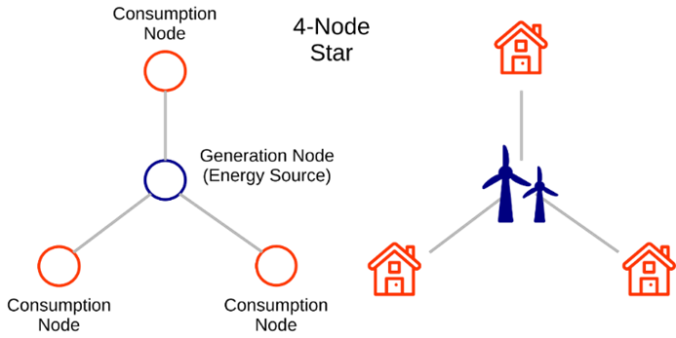
Solution
Consumer demand information is collected centrally and evaluated against current supply conditions
Resulting proposed price information is sent back to customers
SOLUTION
4 - Node Star
Create a model that predicts grid instability
Determine factors that contribute to grid instability

Slide 5
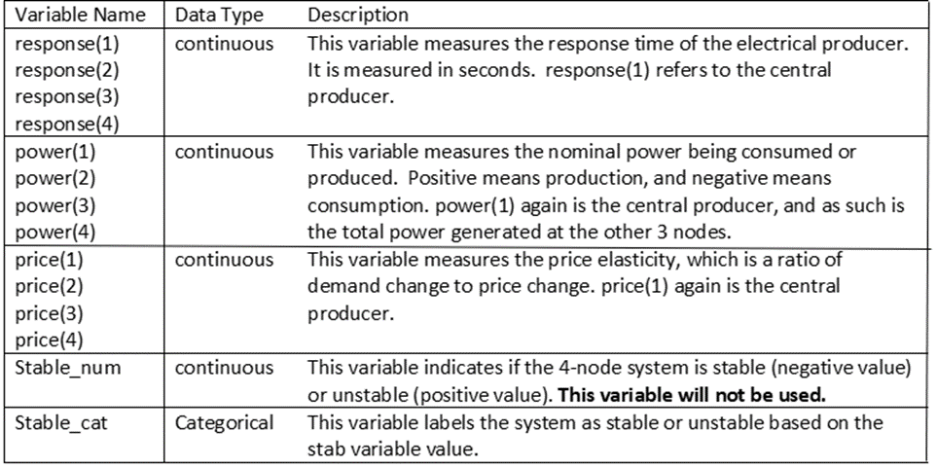

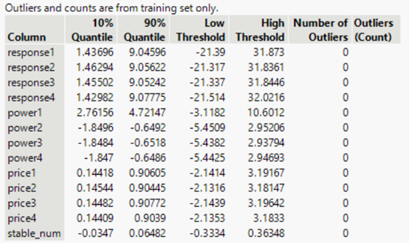
Understanding the Data
Link: https://archive.ics.uci.edu/ml/datasets.php?format=&task=&att=&area=&numAtt=10to100&numIns=greater1000&type=&sort=attUp&view=table
Data Source
UCI Machine Learning Repository.
Summary Measures and Distribution analysis was completed and found all variables to reasonable and symmetric.
THE DATA
The data is composed of 14 attributes and 10,000 entries
All variables, except for the Target Variable are continuous
The dataset contains no missing values, and it has a convenient conversion to a binary variable.
No outliers were identified during preliminary analysis
Normal data patterns
Data Analysis

Slide 6
Models Overview
Subtitle
Logistic Regression
Principal Component Analysis
Logistic regression was run using the target variable stable_cat and the 8 predictor variables found to be significant.
The Linear model resulted in a R square value of 0.5585 for the Training set and 0.5686 for the Validation set. The f-test being <0.001 indicates a significant model was developed.
The PCA was run with the 8 variables that were significant which gave better results.
The Eigenvalues were greater than 1 for the first 4 components and less than 1 for the last 4.
After logistic regression was run PC 5 had a .0607 p-value. It was decided to remove and run the regression again to optimize results.
The generalized R square for training was .5581 and for validation was .5686. AICc was 5898.49 and BIC was 5960.77
Logistic Regression
Principal Component Analysis
4 Data Minning Models Analyzed for This Proposal
Neural Network
Boosted Decision Tree
Neural Network
Boosted Decision Tree
Neural network model was developed using all of the available predictors.
The default model has one hidden layer with three nodes using the TanH activation function.
the ROC curve plot, confusion matrix, and Left Curve all support this model with highest predicted probability for the response level.
The decision tree developed using the binary variable, stable_cat and only the significant variables from Logistic Regression.
The generalized R squared for this tree is 0.964 (Training) and 0.8570 (Validation).
The AUC is 1 for the Training and 0.9838 for the Validation, further supporting the predictive power of this model.
Models Overview

Slide 7

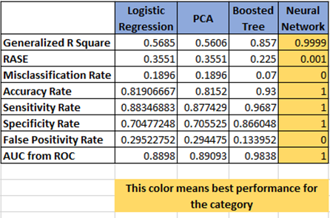
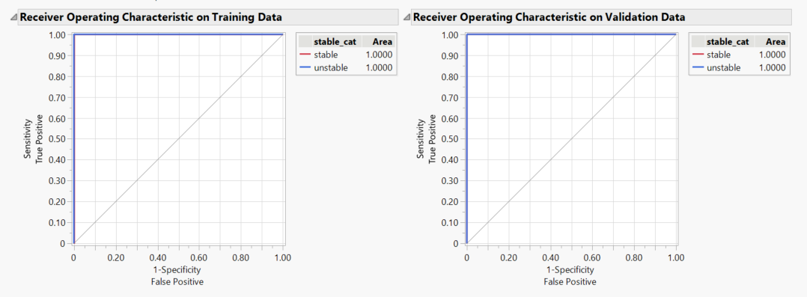
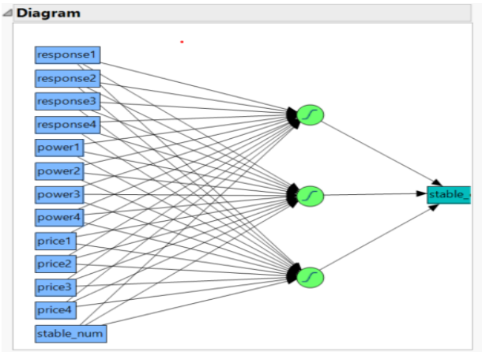
Model selection
Neural Network Model Selected
Confusion matrix used to measure performance of each of the four methods
Neural Network produced the best result in every given criteria
  In ROC Curve Plot the model perfectly rank-orders the response values, because the sorted data contains all of the values first, followed by all the other values.
  The generalized Rsquare is the highest, Training model 0.9999908, Validation model 0.9999829
  Accuracy Rate is 100%
  Misclassification Rate is 0
Given the results produced we recommend selecting the Neural Network model for this analysis.
Neural Network Receiver Operating Characteristic (ROC)
Neural Network Model

Slide 8
Conclusions and Recommendations
Stability in the 4-star node electrical grid is explainable and predictable.
Neural Network provides near perfect results in its ability to predict for this data. It is our recommended model moving forward.
Next steps could include testing the model on other 4-node electrical grids or expanding to other grid types.

